Slide 1
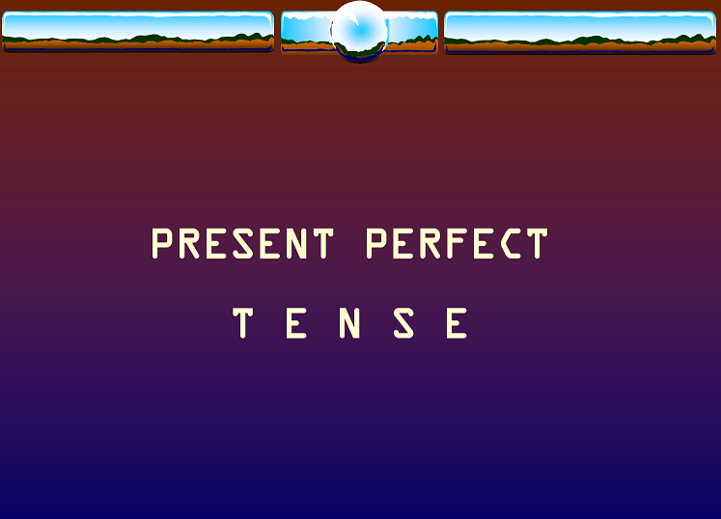

Slide 2
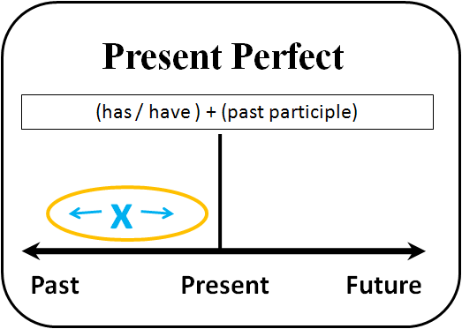

Slide 3
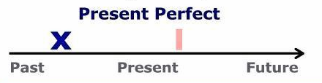
We use the Present Perfect for actions in the past which have a connection to the present. The time when these actions happened is not important.
Example:
I have played tennis.
He has sold his car.

Slide 4
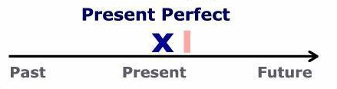
We use the Present Perfect for recently completed actions.
Example:
I have finished my report.
She has sent the email.

Slide 5
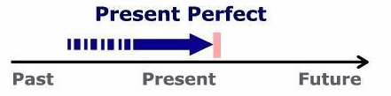
We can use the Present Perfect for actions beginning in the past and still continuing.
Example:
I have worked in this company for 6 years.
John has not slept in the last two days.

Slide 6
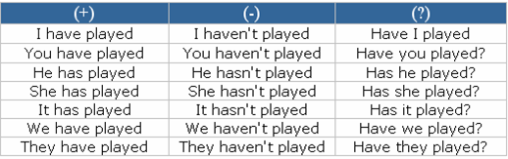
Present Perfect – Regular Verbs

Slide 7
Present Perfect – Irregular Verbs
(+) | ( - ) | (?)
I have gone | I haven't gone | Have I gone ?
You have gone | You haven't gone | Have you gone ?
He has gone | He hasn't gone | Has he gone ?
She has gone | She hasn't gone | Has she gone ?
It has gone | It hasn't gone | Has it gone ?
We have gone | We haven't gone | Have we gone ?
You have gone | You haven't gone | Have you gone ?
They have gone | They haven't gone | Have they gone ?

Slide 8

ever
We often use “ever” in questions about the indefinite past or present perfect. It means “at some time before now”.
Have you ever been to New York?
Have you ever traveled abroad?
Has she ever read Borges?

Slide 9
never
We often use “never” with this tense. It means: “at not time before now”.
Have you ever been to New York?
No, I have never been to NY.
Have you ever traveled abroad?
No, I have never left my city.
Has she ever read Borges?
No, she has never read Borges, but she has read other great authors.

Slide 10
Just, recently & lately
We use just, recently and lately to talk about actions that happened in the very recent past.
In American English we also use “just” and “recently” with the past simple.
Be careful with the order of these words in a sentence
Yet (still, until the present time), is used in questions and negative sentences.
He has just sent the email.
They have recently offered her a job.
I have talked to him recently.
She hasn’t seen him lately.
Have you ordered her book yet?
I’m hungry, I haven’t had lunch yet.

Slide 11
For and since
We use for with a period of time, for example:
a few days, half an hour, two years.
We use since with the time when the action started, for example:
last year, June 8, I met you, I was a child.

Slide 12
For or since?
last weekend
ten seconds
Christmas Eve
a decade
I finished school
a couple of days
my birthday
ten centuries
the 70s
I was a boy
August
the last month
fifteen years
the accident
then
we bought this house
last month

Slide 13
Simple Past vs. Present Perfect
When do we use each tense in English?
Use the simple past for an action that happened in the past and is: over, done, finished!
Use the present perfect for an action that started in the past, but . . . is still true today.
The simple past always refers to an action or situation that is finished. The present perfect connects the past and the present. It is used to show that an action or situation in the past continues today, or might happen again.

Slide 14
Compare the meaning of these two sentences:
1. Sara lived in Boston for 5 years. (Simple Past)
2. Sara has lived in Boston for 5 years. (Present Perfect)
1. In the first sentence by using the simple past tense, we mean that Sara started living in Boston 5 years ago . . . AND . . . then she moved! Now she lives in a different city, like Paris. Remember, the simple past is used for a situation that is over, finished, done!
2. By using the present perfect tense in the second sentence, we mean that Sara began living in Boston 5 years ago . . . AND . . . she still lives there. Remember, the present perfect tense connects the past with the present.

Slide 15
Use the simple past with time words like:
yesterday, last Saturday, week, month, year, etc., _______ ago, when I was…, in 1990 (past date).
Use the present perfect with time words like: recently/lately, since …, so far, this week, a month, twenty years, etc.

Slide 16


Slide 17
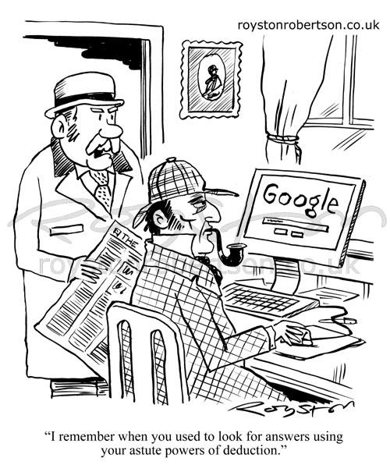

Slide 18
We use 'used to' for something that happened regularly in the past but no longer happens:
I used to smoke a packet a day but I stopped two years ago.
Ben used to travel a lot in his job but now, since his promotion, he doesn't.
I used to drive to work but now I take the bus.
We also use it for something that was true but no longer is:
There used to be a cinema in the town but now there isn't.
She used to have really long hair but she's had it all cut off.
I didn't use to like him but now I do.

Slide 19
Used to always has a past meaning, but we only use it for something that happened regularly. We can't use it for something that happened only one time in the past. For one-time past events we use the simple past tense.
We use the negative form didn’t use to to talk about things that did not happen regularly in the past. Notice that there is no -d at the end of the word “use”. We can also use the expression never used to:
She didn’t use to play tennis when she was younger.
She never used to play tennis when she was younger.

Slide 20
To ask a question we use Did + use to…? Again, notice that there is no -d at the end of the word “use”:
Did he use to like going to the sea on holidays?
Did you use to like English when you were at the secondary school?

Slide 21

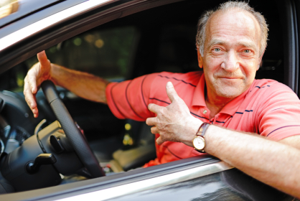
Look at the pictures and use the prompts below to make sentences about Thomas e.g. Thomas used to …, now he…:
20 years ago: Now:
Do a lot of sport Not do any sport
Have a lot of hair Not have much hair
Be quite slim Be overweight
Not have a girlfriend Be married
Have a bicycle Have a car
Not have much money Get a good salary

Slide 22


Slide 23
Present Perfect:
http://www.ompersonal.com.ar/ELEMENTARY/unit19/page2.htm (includes a verb list)
http://www.ompersonal.com.ar/ELEMENTARY/unit19/page3.htm
Present Perfect and Past Simple:
http://www.ompersonal.com.ar/omgrammar/presentperfect-pastsimple.htm
http://www.ompersonal.com.ar/INTERMEDIATE/unit5/page3.htm

Slide 24
Used to:
http://www.ompersonal.com.ar/INTERMEDIATE/unit2/page4.htm
http://www.ompersonal.com.ar/INTERMEDIATE/unit2/page5.htm
http://www.ompersonal.com.ar/INTERMEDIATE/unit2/page6.htm (Reading Comprehension)

